Slide 1

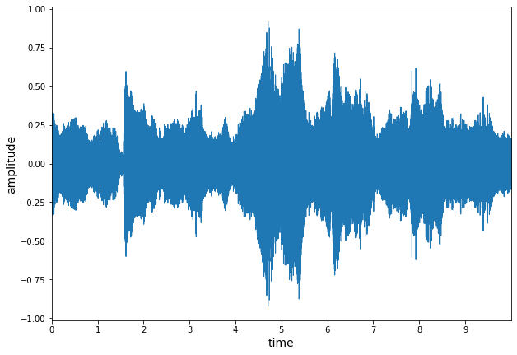
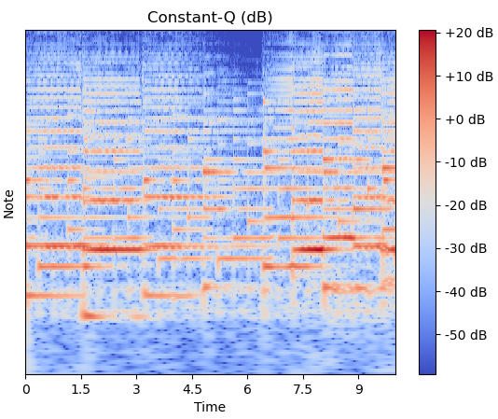
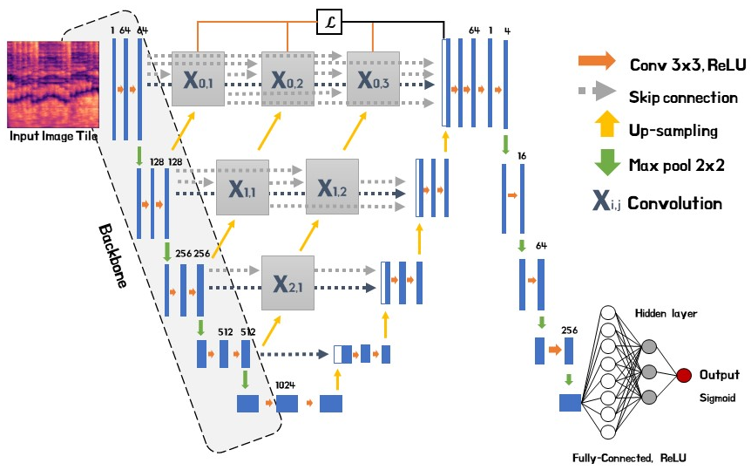
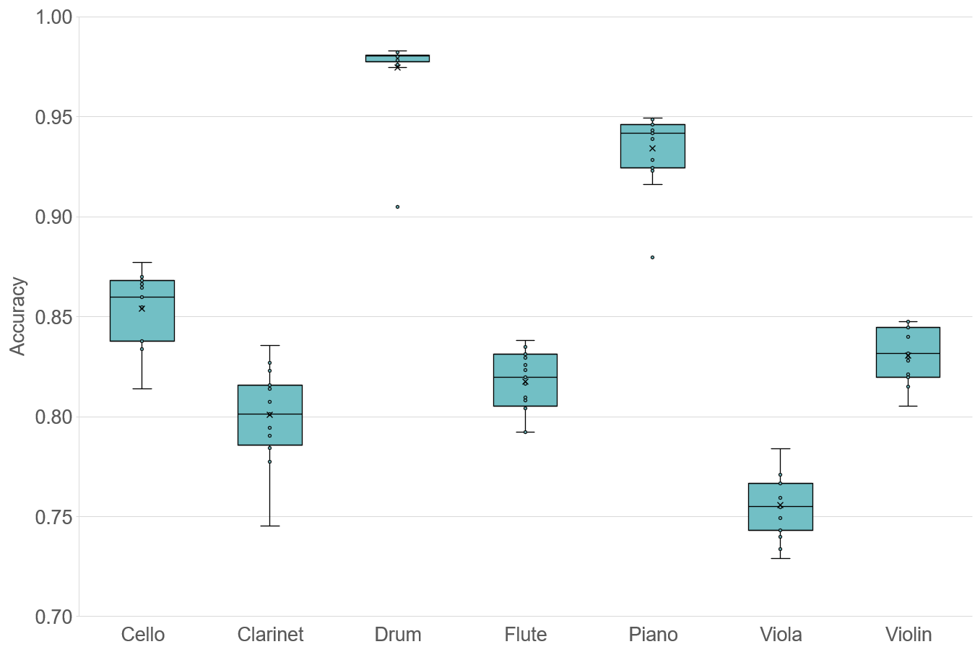
KNU-EERC Paper Awards: Undergraduate Poster Competition
Classification of Musical Instruments
using Convolutional Neural Network
Sun Woo Park, Byeong Jun Park, Sangtae Ahn*
School of Electronic and Electrical Engineering, Kyungpook National University
Introduction
U-Net [5] is an encoder/decoder CNN architecture with skip connections, which has been used for vocal separation [6]. In Figure 3, we have added UNet++ [7], which is a redesigned U-Net that has a deeply-supervised encoder/decoder network. We used multi-label classification [8] to distinguish whether each instrument class is present or not. To this end, each model is designed with a binary classification method. Thus, a set of outputs from each model generated the final output.
In the field of deep learning, many studies on sound data processing have been conducted. Most of the studies were natural language processing [1] and text-to-speech [2], but there were few studies on the problem of Musical Instrument Classification (MIC) [3]. Spectrogram is one of the methods for processing sound data. It is a tool for visualizing and grasping sounds or waves and a combination of waveform and spectral features. Through the spectrogram, the sound classification problem can be applied as an image classification problem. The convolutional neural network (CNN) is used to process image data and is well applied to image recognition and classification problems.
In this work, thus, we aim to designed a deep learning model using CNN to solve the MIC problem. We will also discuss the approach of data pre-processing so that processed data can be properly applied to the model.
Results
Data Challenges & Our Approach
Figure 4. Distribution of classification accuracy for each musical instrument
Figure 1. Dataset ratio of each musical instrument
Instrument | Cello | Clarinet | Drum | Flute | Piano | Viola | Violin
Best accuracy(%) | 87.85 | 84.90 | 97.57 | 84.58 | 93.53 | 77.91 | 84.44
Table 1. Best classification accuracy of each musical instrument
As seen in Figure 4, the results show reasonably high classification accuracies for each musical instrument. Even if it passes the same model, the accuracy varies from instrument to instrument. However, low accuracy for three or more ensembles also appears compared with significantly higher accuracy for solo and duet.
Figure 2. Left: Raw waveform. Right: Constant-Q power spectrum
Discussion & Conclusions
We used a dataset of 28,668 data collected from 577 videos on the web. The dataset consists of a solo and ensemble of 7 instruments (cello, clarinet, drum, flute, piano, viola, violin). As shown in Figure 1, we divided our dataset in ratio of 6:2:2 on random selection basis to train, validate and test each musical instrument model. This ratio reflects not only solo performances of each instrument but also duets with all other instruments. To pass the sound waveform through the CNN model, we preprocessed the data into spectrogram using the constant-Q transform (CQT) [4] as seen in Figure 2.
We introduce a method to classify musical instrument using convolutional neural network and spectrogram. We observed that the sound range of the instrument affected the classification performance of the model. We expect improved classification performance if the dataset is well organized. In the view of these features, there is a possibility that this sound classification mechanism may be applied not only to musical instruments but also to other subjects. In future work, we would like to investigate further approaches to accurately classify three or more sounds (and possibly even orchestras).
Model Architecture
References
[1] P. Lewis, E. Perez, A. Piktus, F. Petroni, V. Karpukhin, N. Goyal, H. Küttler, M. Lewis, W.-tau Yih, T. Rocktäschel, S. Riedel, and D. Kiela, “Retrieval-augmented generation for knowledge-intensive NLP tasks,” arXiv.org, 12-Apr-2021.
[2] J. Shen, R. Pang, R. J. Weiss, M. Schuster, N. Jaitly, Z. Yang, Z. Chen, Y. Zhang, Y. Wang, R. Skerrv-Ryan, R. A. Saurous, Y. Agiomvrgiannakis, and Y. Wu, “Natural TTS synthesis by conditioning wavenet on Mel Spectrogram predictions,” 2018 IEEE International Conference on Acoustics, Speech and Signal Processing (ICASSP), 2018.
[3] K. Racharla, V. Kumar, C. B. Jayant, A. Khairkar, and P. Harish, “Predominant musical instrument classification based on spectral features,” 2020 7th International Conference on Signal Processing and Integrated Networks (SPIN), 2020.
[4] K. W. Cheuk, K. Agres, and D. Herremans, “The impact of audio input representations on neural network based music transcription,” 2020 International Joint Conference on Neural Networks (IJCNN), 2020.
[5] O. Ronneberger, P. Fischer, and T. Brox, “U-Net: Convolutional Networks for Biomedical Image Segmentation,” Lecture Notes in Computer Science, pp. 234–241, 2015.
[6] R. Hennequin, A. Khlif, F. Voituret, and M. Moussallam, “Spleeter: A fast and efficient music source separation tool with pre-trained models,” Journal of Open Source Software, vol. 5, no. 50, p. 2154, 2020.
[7] Z. Zhou, M. M. Rahman Siddiquee, N. Tajbakhsh, and J. Liang, “UNet++: A nested U-Net Architecture for Medical Image segmentation,” Deep Learning in Medical Image Analysis and Multimodal Learning for Clinical Decision Support, pp. 3–11, 2018.
[8] J. Read and F. Perez-Cruz, “Deep learning for multi-label classification,” arXiv preprint arXiv:1502.05988, 2014.
Figure 3. Our suggested model architecture

